Slide 1
Data structures and algorithms - Fundamentals

Slide 2
Data Structures and Algorithms – Definitions
In the most general sense, a data structure is any data representation and its
associated operations. Even an integer or floating point number stored on the computer can be viewed as a simple data structure.
In computer science, a data structure is a particular way of organizing data in a computer so that it can be used efficiently.* Data structures can implement one or more particular Abstract Data Types (ADT)
Usually, efficient data structures are key to designing efficient algorithms
Notes:
* - Entry data structure in the Encyclopedia Britannica

Slide 3
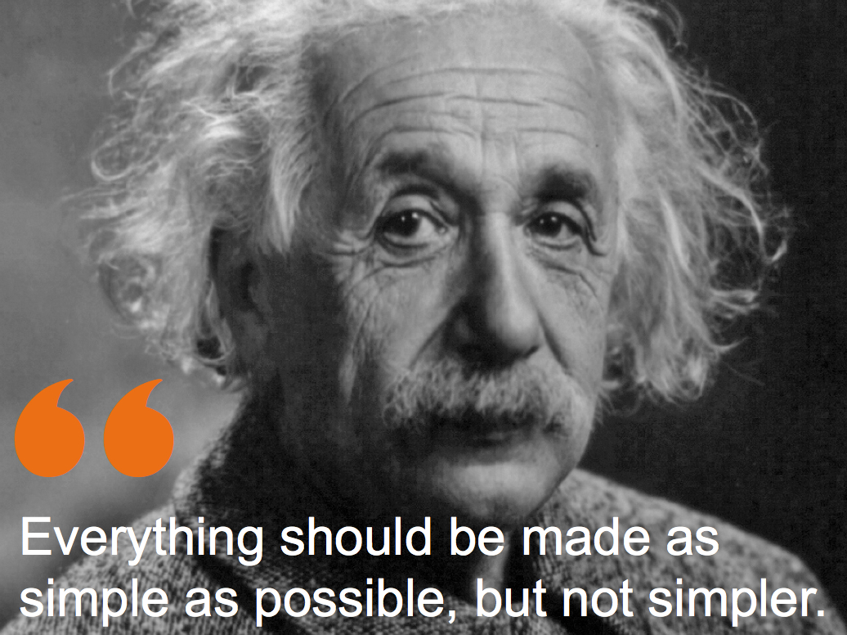
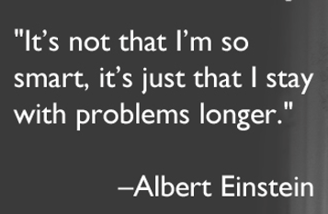
Data Structures and Algorithms

Slide 4
Data Structures and Algorithms
Each data structure and each algorithm has costs and benefits. Practitioners
need a thorough understanding of how to assess costs and benefits to be able
to adapt to new design challenges. This requires an understanding of the
principles of algorithm analysis, and also an appreciation for the significant
effects of the physical medium employed (e.g., data stored on disk versus
main memory).
Related to costs and benefits is the notion of tradeoffs. For example, it is quite
common to reduce time requirements at the expense of an increase in space
requirements, or vice versa. Programmers face tradeoff issues regularly during the phases of software design and implementation, so the concept must become
deeply ingrained.
Programmers should know enough about common practice to avoid reinventing
the wheel. Thus, programmers need to learn the commonly used
data structures, their related algorithms, and the most frequently encountered
design patterns found in programming.
Data structures follow needs. Programmers must learn to assess application
needs first, then find a data structure with matching capabilities.

Slide 5
Fundamental Data Structures
Array/ Dynamic Array
List / Stack and Queue
Tree – binary Trees
Non Binary Trees
Graphs

Slide 6
Basic data structures - Array
Definition: Contiguous block of memory locations, where each memory location stores one fixed-length data item. It could also mean a logical data type composed of a (typically homogeneous) collection of data items, with each data item identified by an index number:
collection of elements of similar datatype
contiguous memory allocation
each element can be accessed directly using position variable
array elements can be accessed individually
0
1
2
N
…
size
size
size
size
Problems with an array:
Array size is fixed
Unsorted array: searching for an item is slow
Sorted array: insertion and deletion is slow

Slide 7
Basic data structures - Array
Examples:
tables, especially lookup table - replaces runtime computation with a simpler array indexing operation.
The savings in terms of processing time can be significant, since retrieving a value from memory is often faster than undergoing an 'expensive' computation.

Slide 8

Basic data structures – List
Definition: Finite, ordered sequence of data items known as elements. “Ordered” in this definition means that each element has a position in the list.
For simplicity all elements of the list should have the same data type
There is no conceptual objection to lists whose elements have differing
data types if the application requires it.
The operations defined as part of the list ADT do not depend on the elemental data type.
Definition: A list is said to be empty when it contains no elements.
Definition: The number of elements currently stored is called the length of the list.
Definition: The beginning of the list is called the head, the end of the list is called the tail.

Slide 9
Basic data structures – List
A program designer should first consider what basic operations the implementation must support. Our common intuition about lists tells us that a list should be able to:
grow and shrink in size as we insert and remove elements.
to insert and remove elements from anywhere in the list.
to gain access to any element’s value, either to read it or to change it.
to create and clear (or reinitialize) lists.
to access the next or previous element from the “current” one.

Slide 10
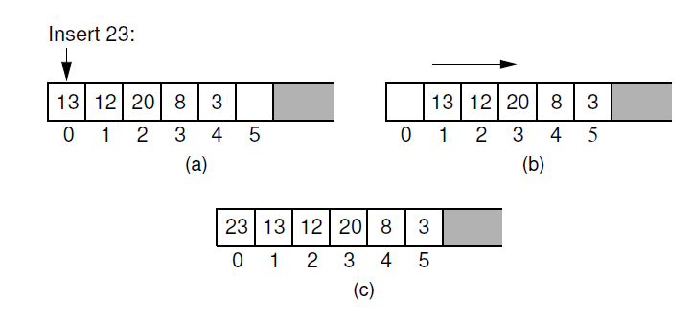
Basic data structures – Array based List
There are two standard approaches to implementing lists, the array-based list, and the linked list.
Inserting an element at the head of an array-based list requires shifting
all existing elements in the array by one position toward the tail:
A list containing five elements before inserting an element with value 23.
The list after shifting all existing elements one position to the right.
The list after 23 has been inserted in array position 0.

Slide 11
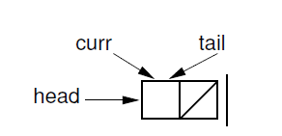
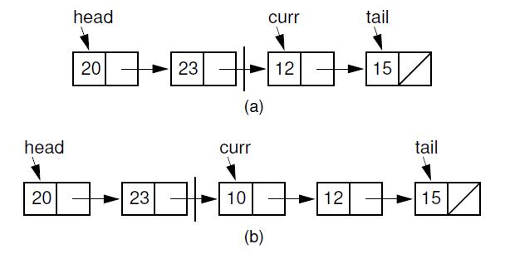
Basic data structures – Linked List
The second traditional approach to implementing lists makes use of pointers and is
usually called a linked list. The linked list uses dynamic memory allocation
Initial state of a linked list when using a header node
Linked list prior to inserting element with value 10.
(b) Desired effect of inserting element with value 10.

Slide 12
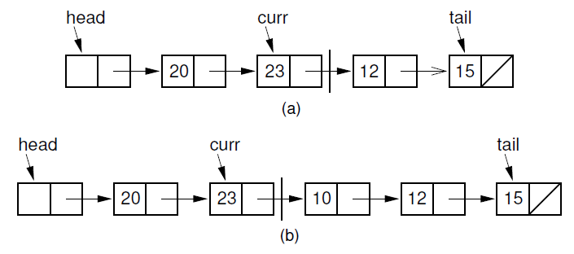
Basic data structures – Linked List
A key design decision for the linked list implementation is how to represent the current position. The most reasonable choices appear to be a pointer to the current element. But there is a big advantage to making curr point to the element preceding the current element.
(a) Linked list before insertion. The current node contains 12.
(b) Linked list after inserting the node containing 10.

Slide 13
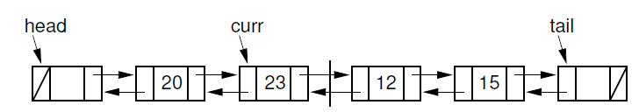
Basic data structures – List
Doubly Linked Lists
Rule: A doubly linked list allows convenient access from a list node to the next node and also to the preceding node on the list.

Slide 14
Basic data structures – Stack
Definition: List-like structure in which elements may be inserted or removed
from only one end.
Rule: While this restriction makes stacks less flexible than lists, it
also makes stacks both efficient and easy to implement.
AKA: “LIFO” list, which stands for “Last-In, First-Out”
100
87
87
87
20
20
20
15
15
15
12
12
12
7
7
7
Original contents
Pop
Push

Slide 15
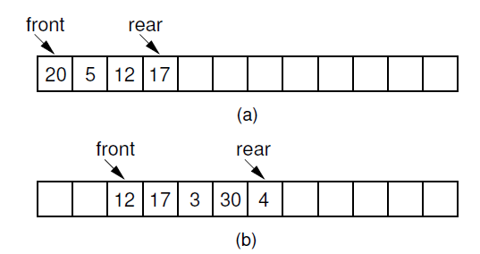
Basic data structures – Queue
Definition: List-like structure that provides restricted access to
its elements.
Rule: Queue elements may only be inserted at the back and removed from the front.
AKA: “FIFO” list, which stands for “First-In, First-Out.
(a) The queue after the initial four numbers 20, 5, 12, and 17 have been inserted.
(b) The queue after elements 20 and 5 are deleted, following
which 3, 30, and 4 are inserted.

Slide 16
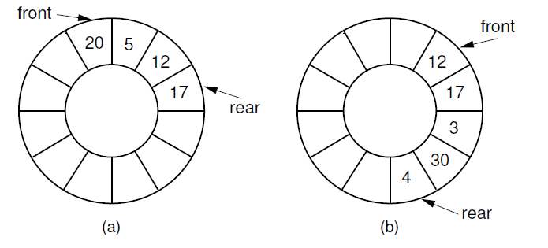
Basic data structures – Queue
(a) The queue after the initial four numbers 20, 5, 12, and 17 have been inserted.
(b) The queue after elements 20 and 5 are deleted, following which 3,
30, and 4 are inserted.

Slide 17
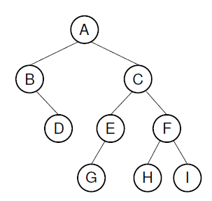
Basic data structures - Trees
Rule: The list representations have a fundamental limitation: Either search or insert can be made efficient, but not both at the same time. Tree structures permit both efficient access and update to large collections of data.
Example: Binary trees are useful for many things besides searching - trees can speed up prioritizing jobs, describing mathematical expressions and the syntactic elements of computer programs, or organizing the information needed to drive data compression algorithms.
Root (level 0)
Child of A
Child of A
Leaves
Leaves

Slide 18
Basic data structures – Binary Trees
Definition: A binary tree is made up of a finite set of elements called nodes.
Rule: This set either is empty or consists of a node called the root together with two binary trees, called the left and right subtrees, which are disjoint from each other and from the root (Disjoint means that they have no nodes in common).
Definition: The roots of these subtrees are children of the root.
Definition: There is an edge from a node to each of its children, and
a node is said to be the parent of its children.
Rule: If n₁, n₂, ..., n_{k} is a sequence of nodes in the tree such that n_{i} is the parent of
n_{i}+1 for 1 < i < k, then this sequence is called a path from n₁ to n_{k}. The length
of the path is k-1.
Rule: All nodes in the tree are descendants of the root of the tree, while the root is the ancestor of all nodes.
Definition: The depth of a node M in the tree is the length of the path from the root of the tree to M.

Slide 19
Basic data structures – Binary Trees
Definition: The height of a tree is one more than the depth of the deepest node in the tree. All nodes of depth d are at level d in the tree. The root is the only node at level 0, and its depth is 0.
Definition: A leaf node is any node that has two empty children.
Definition: An internal node is any node that has at least one non-empty child.

Slide 20
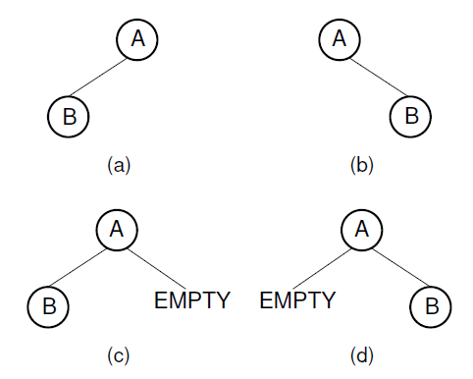
Basic data structures - Trees
Two different binary trees. (a) A binary tree whose root has a nonempty
left child. (b) A binary tree whose root has a non-empty right child. (c) The
binary tree of (a) with the missing right child made explicit. (d) The binary tree
of (b) with the missing left child made explicit.

Slide 21
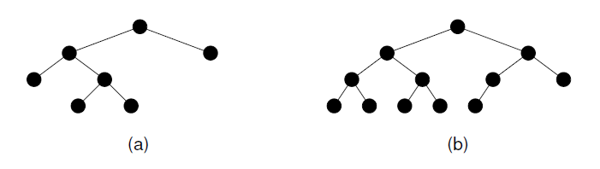
Basic data structures - Trees
This tree is full (but not complete).
This tree is complete (but not full).
Rule: Two restricted forms of binary tree are sufficiently important to warrant special
names:
each node in a full binary tree is either an internal node with exactly
two non-empty children or a leaf
a complete binary tree has a restricted shape obtained by starting at the root and filling the tree by levels from left to right
In the complete binary tree of height d, all levels except possibly level d-1 are completely full. The bottom level has its nodes filled in from the left side

Slide 22
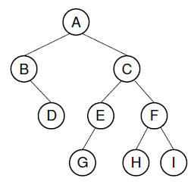
Basic data structures – Binary Tree Traversal
Definition: Any process for visiting all of the nodes in some order is called a traversal. Any traversal that lists every node in the tree exactly once is called an enumeration of the tree’s nodes.
Definition: We might wish to make sure that we visit any given node before we visit its children. This is called a preorder traversal.
The preorder enumeration for the tree is ABDCEGFHI:
The first node printed is the root. Then all nodes of the left subtree are
printed (in preorder) before any node of the right subtree.

Slide 23
Basic data structures – Binary Tree Traversal
Definition: Alternatively, we might wish to visit each node only after we visit its children (and their subtrees). We would like to delete the children of a node
before deleting the node itself. This is called a postorder traversal.
The postorder enumeration is: DBGEHIFCA:
Definition: An inorder traversal first visits the left child (including its entire subtree), then visits the node, and finally visits the right child (including its entire subtree).
The inorder enumeration is:
BDAGECHFI:

Slide 24
Basic data structures – Non Binary Trees
Major Definition: A tree T is a finite set of one or more nodes such that there is one designated node R, called the root of T. If the set (T-{R}) is not empty, these nodes are partitioned into n > 0 disjoint subsets T0, T1, ..., Tn-1, each of which is a tree, and whose roots R1, R2, ..., Rn, respectively, are children of R. The subsets Ti (0 < i < n) are said to be subtrees of T.
Major Rules: These subtrees are ordered in that Ti is said to come before Tj if i < j. By convention, the subtrees are arranged from left to right with subtree T0 called the leftmost child of R.
Definition: A node’s out degree is the number of children for that node. A forest is a collection of one or more trees.
Rule: Each node in a tree has precisely one parent, except for the root, which has no parent. From this observation, it immediately follows that a tree with n nodes must have n -1 edges because each node, aside from the root, has one edge connecting that node to its parent.

Slide 25
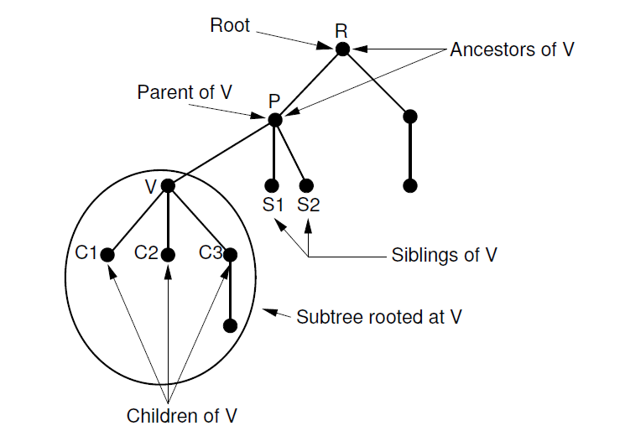
Basic data structures - Trees
Notation for general trees. Node P is the parent of nodes V, S1,
and S2. Thus, V, S1, and S2 are children of P. Nodes R and P are ancestors of V.
Nodes V, S1, and S2 are called siblings. The oval surrounds the subtree having V
as its root.

Slide 26
Basic data structures – Graphs
Rules: Graphs provide the ultimate in data structure flexibility. Graphs can model both real-world systems and abstract problems, so they are used in hundreds of applications.
Here is a small sampling of the range of problems that graphs are routinely
applied to.
1. Modeling connectivity in computer and communications networks.
2. Representing a map as a set of locations with distances between locations;
used to compute shortest routes between locations.
3. Modeling flow capacities in transportation networks.
4. Finding a path from a starting condition to a goal condition; for example, in
artificial intelligence problem solving.
5. Modeling computer algorithms, showing transitions from one program state
to another.
6. Finding an acceptable order for finishing subtasks in a complex activity, such
as constructing large buildings.
7. Modeling relationships such as family trees, business or military organizations,
and scientific taxonomies.

Slide 27
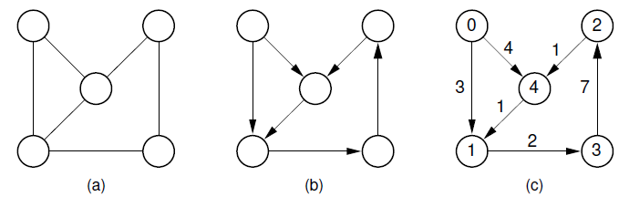
Basic data structures – Graphs
Examples of graphs and terminology: (a) A graph. (b) A directed graph (digraph).
(c) A labeled (directed) graph with weights associated with the edges. In this example, there is a simple path from Vertex 0 to Vertex 3 containing Vertices 0, 1, and 3. Vertices 0, 1, 3, 2, 4, and 1 also form a path, but not a simple path because Vertex 1 appears twice. Vertices 1, 3, 2, 4, and 1 form a simple cycle.

Slide 28
Basic data structures – Graphs
Major Definitions: A graph G = (V;E) consists of a set of vertices V and a set of edges E, such that each edge in E is a connection between a pair of vertices in V.
The number of vertices is written |V|, and the number of edges is written |E|. |E| can range from zero to a maximum of |V|² -|V|. A graph with relatively few edges is called sparse, while a graph with many edges is called dense. A graph containing all possible edges is said to be complete.
A graph with edges directed from one vertex to another is called a directed graph or digraph. A graph whose edges are not directed is called an undirected graph.
A graph with labels associated with its vertices is called a labeled graph.
Two vertices are adjacent if they are joined by an edge. Such vertices are also called neighbors.
An edge connecting Vertices U and V is written (U, V). Such an edge is said to be incident on Vertices U and V. Associated with each edge may be a cost or weight.
Graphs whose edges have weights are said to be weighted.

Slide 29
Basic data structures – Graphs
A sequence of vertices v1, v2, ..., vn forms a path of length n -1 if there exist edges from vi to vi+1 for 1 < i < n.
A path is simple if all vertices on the path are distinct. The length of a path is the number of edges it contains.
A cycle is a path of length three or more that connects some vertex v1 to itself. A cycle is simple if the path is simple, except for the first and last vertices being the same.

Slide 30
Basic data structures – Graph Traversals
Often it is useful to visit the vertices of a graph in some specific order based on the graph’s topology:
Definition:. This is known as a graph traversal and is similar in concept to a tree traversal. Recall that tree traversals visit every node exactly once, in some specified order such as preorder, inorder, or postorder.
Rule: Graph traversal algorithms typically begin with a start vertex and attempt to
visit the remaining vertices from there.
Edge case: It may not be possible to reach all vertices from the start vertex. This occurs when the graph is not connected.
Edge case: The graph may contain cycles, and we must make sure that cycles do not cause the algorithm to go into an infinite loop.

Slide 31
Basic data structures – Graph Traversals
Rule: Graph traversal algorithms can solve both of these problems by maintaining a mark bit for each vertex on the graph. At the beginning of the algorithm, the mark bit for all vertices is cleared. The mark bit for a vertex is set when the vertex is first visited during the traversal. If a marked vertex is encountered during traversal, it is not visited a second time. This keeps the program from going into an infinite loop when it encounters a cycle.
Rule: Once the traversal algorithm completes, we can check to see if all vertices have been processed by checking the mark bit array. If not all vertices are marked, we can continue the traversal from another unmarked vertex.

Slide 32
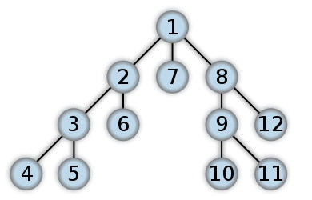
Basic data structures – Graph Traversals
Depth-First Search (DFS) and Breadth-First Search (BFS)
Definition: The first method of organized graph traversal is called depth-first search (DFS).
Whenever a vertex V is visited during the search, DFS will recursively visit all
of V’s unvisited neighbors. Equivalently, DFS will add all edges leading out of v
to a stack. The next vertex to be visited is determined by popping the stack and
following that edge.
The effect is to follow one branch through the graph to its conclusion, then it will back up and follow another branch, and so on.

Slide 33
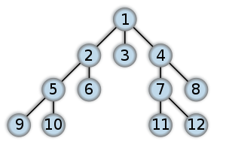
Basic data structures – Graph Traversals
Definition: The second graph traversal algorithm is known as a breadth-first search (BFS).
BFS examines all vertices connected to the start vertex before visiting vertices further away.
BFS is implemented similarly to DFS, except that a queue replaces
the recursion stack.
Note that if the graph is a tree and the start vertex is at the
root, BFS is equivalent to visiting vertices level by level from top to bottom

Slide 34
Basic data structures – Graph Traversals
Shortest-Paths Problem
On a road map, a road connecting two towns is typically labeled with its distance.
We can model a road network as a directed graph whose edges are labeled with
real numbers. These numbers represent the distance (or other cost metric, such as
travel time) between two vertices. These labels may be called weights, costs, or
distances, depending on the application. Given such a graph, a typical problem
is to find the total length of the shortest path between two specified vertices. This
is not a trivial problem, because the shortest path may not be along the edge (if
any) connecting two vertices, but rather may be along a path involving one or more
intermediate vertices.

Slide 35
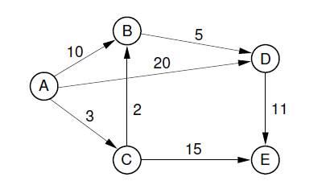
Basic data structures – Graphs
Example graph for shortest-path definitions

Slide 36
Basic data structures – Algorithms
Algorithms

Slide 37
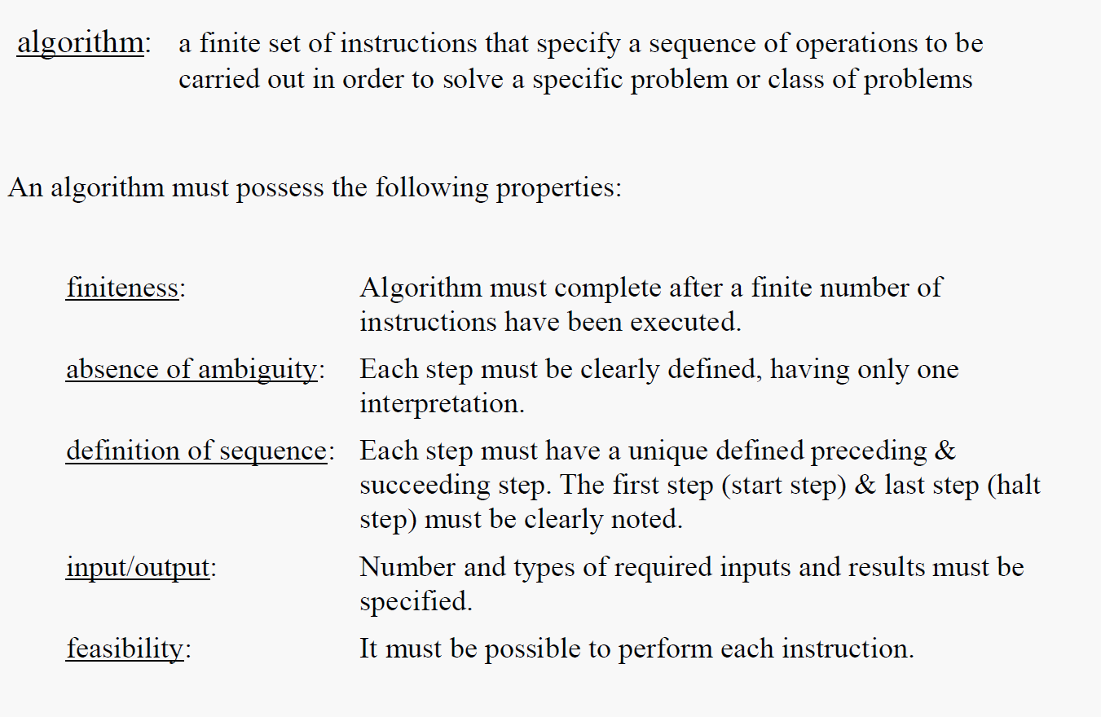
Algorithm analysis

Slide 38
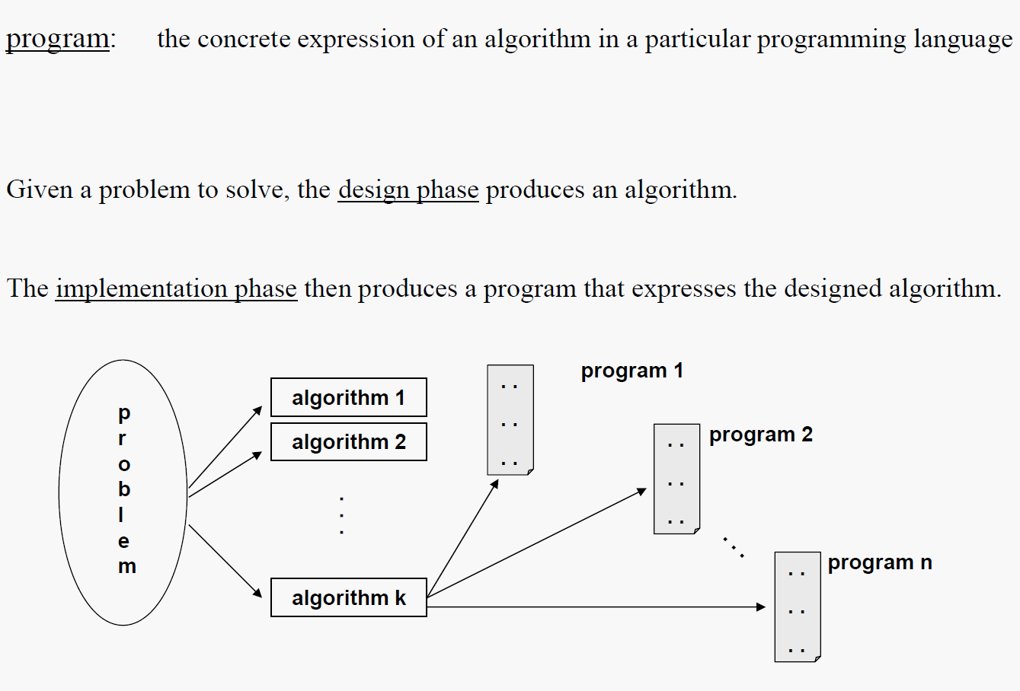
Algorithm analysis

Slide 39
Algorithm analysis
Given a particular problem, there are typically a number of different algorithms that will solve that problem. A designer must make a rational choice among those algorithms.
Design considerations:
to design an algorithm that is easy to understand, implement, and debug (software engineering)
to design an algorithm that makes efficient use of the available computational resources (data structures and algorithm analysis)
We will be primarily concerned with the second area.
But, how do we measure the efficiency of an algorithm?
Note that the number of operations to be performed and the space required will depend on the number of input values that must be processed.

Slide 40
Algorithm analysis
It is tempting to measure the efficiency of an algorithm by producing an implementation and then performing benchmarking analyses by running the program on input data of varying sizes and measuring the "wall clock" time for execution.
However:
- the program may be a poor representation of the algorithm's possibilities.
- the results will depend upon the particular characteristics of the hardware used for the benchmarking, perhaps in subtle ways.
- the choice of test data may not provide a representative sampling of the various factors that influence the algorithm's behavior

Slide 41
Algorithm analysis
Complexity analysis is the systematic study of the cost of a computation, measured either in time units or in operations performed, or in the amount of storage space required.
The goal is to have a meaningful measure that permits comparison of algorithms and/or implementations independent of operating platform.
Complexity analysis involves two distinct phases:
algorithm analysis: analysis of the algorithm or data structure to produce a function O(n) measuring the complexity
order of magnitude (asymptotic) analysis: analysis of the function O(n) to determine the general complexity category to which it belongs.
Algorithm analysis requires a set of rules to determine how operations are to be counted. There is no generally accepted set of rules for algorithm analysis.
In some cases, an exact count of operations is desired; in other cases, a general approximation is sufficient.
The rules presented that follow are typical of those intended to produce an exact count of operations.

Slide 42
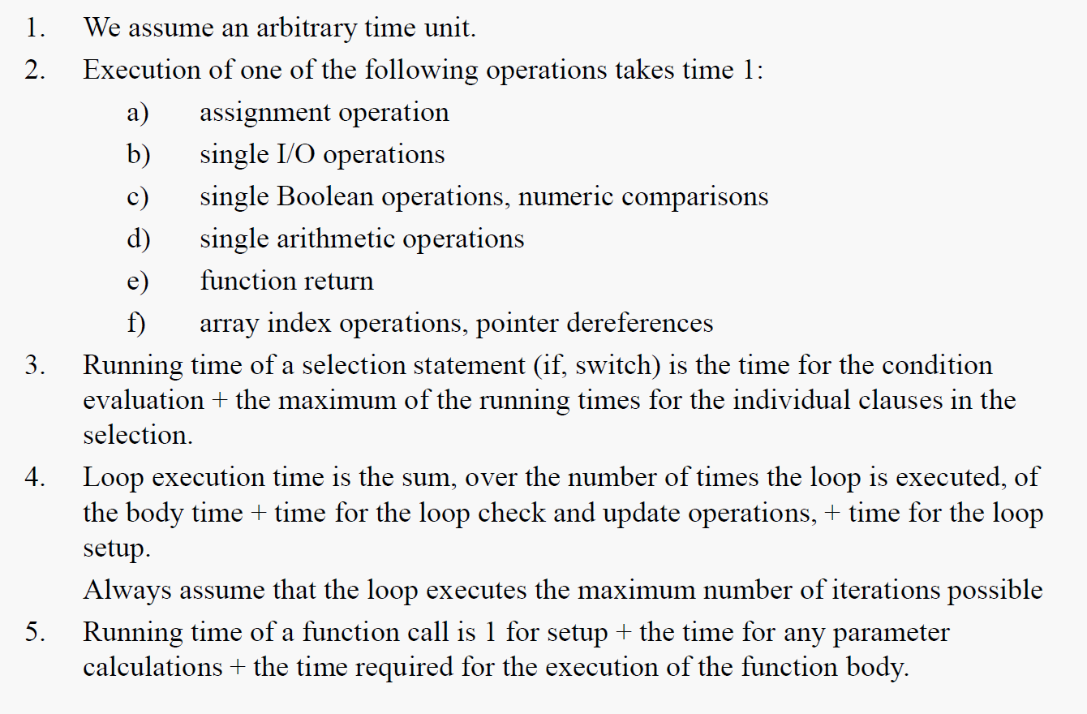
Algorithm analysis

Slide 43
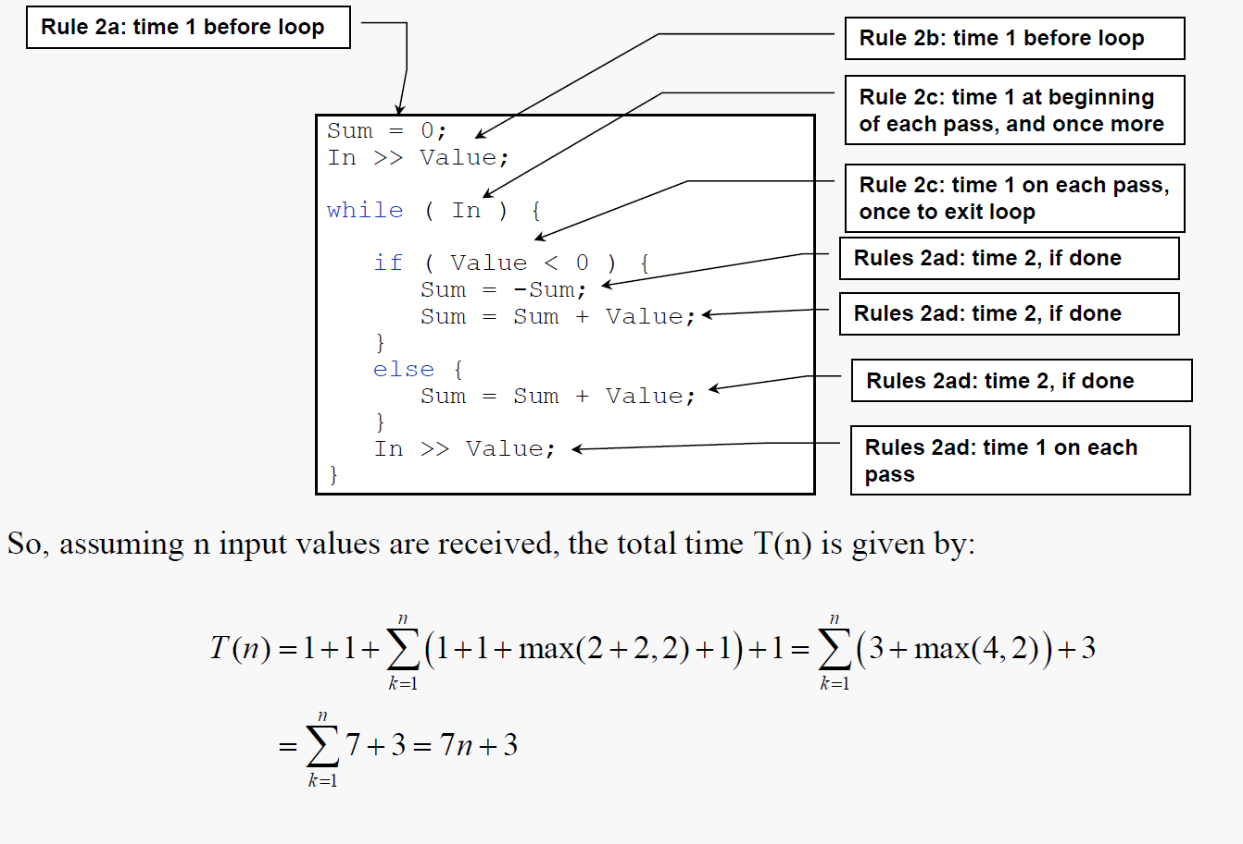
Algorithm analysis

Slide 44
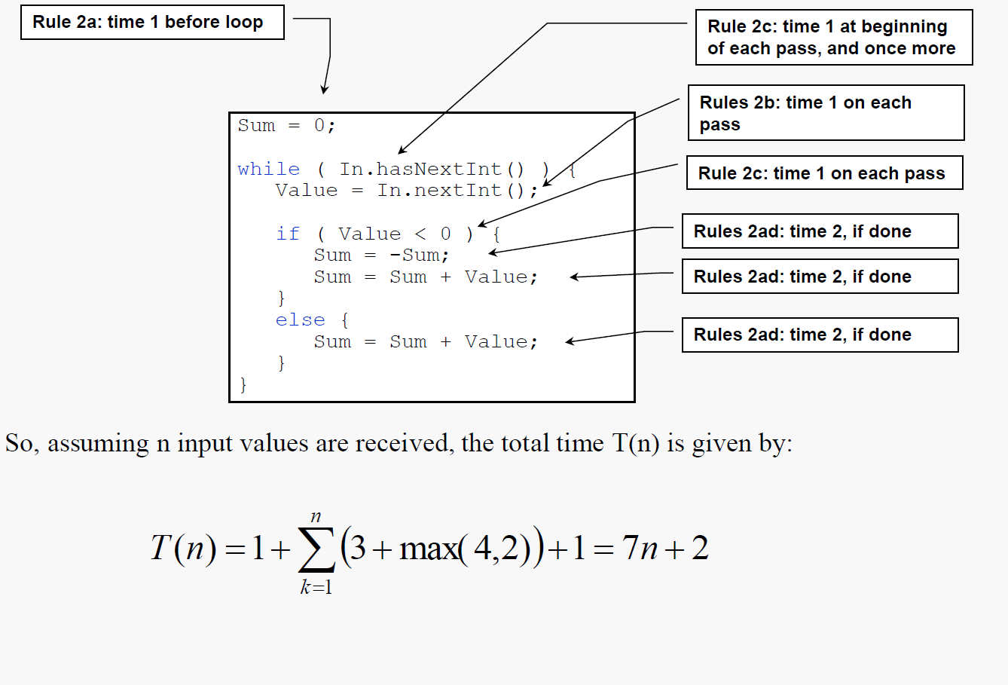
Algorithm analysis

Slide 45
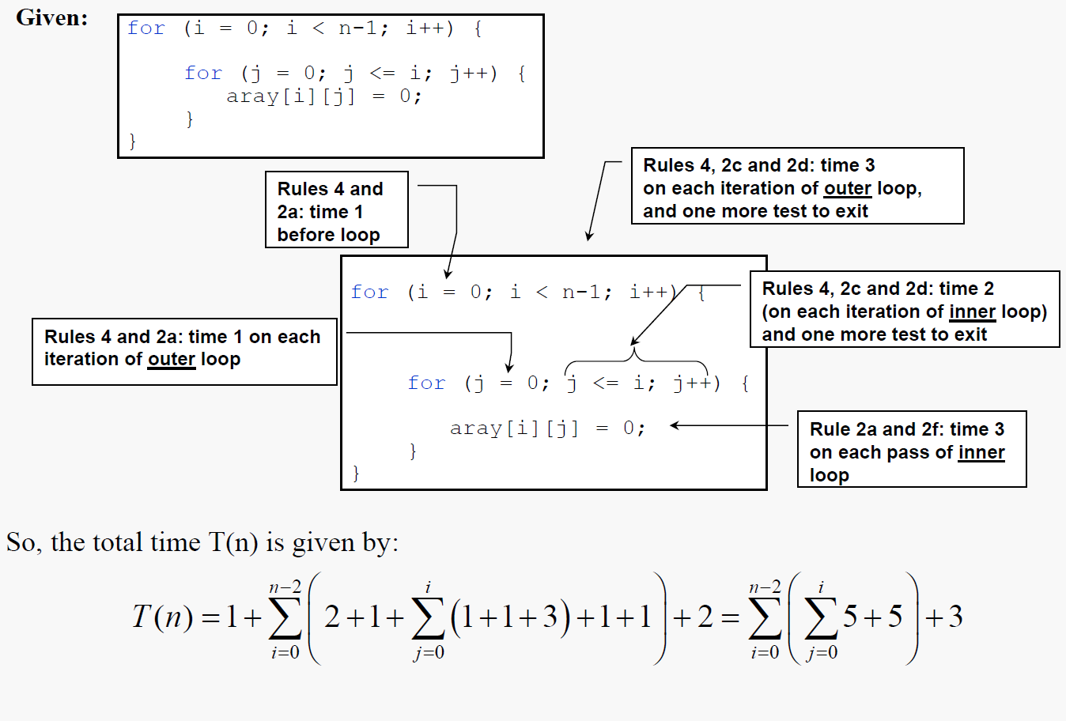
Algorithm analysis

Slide 46
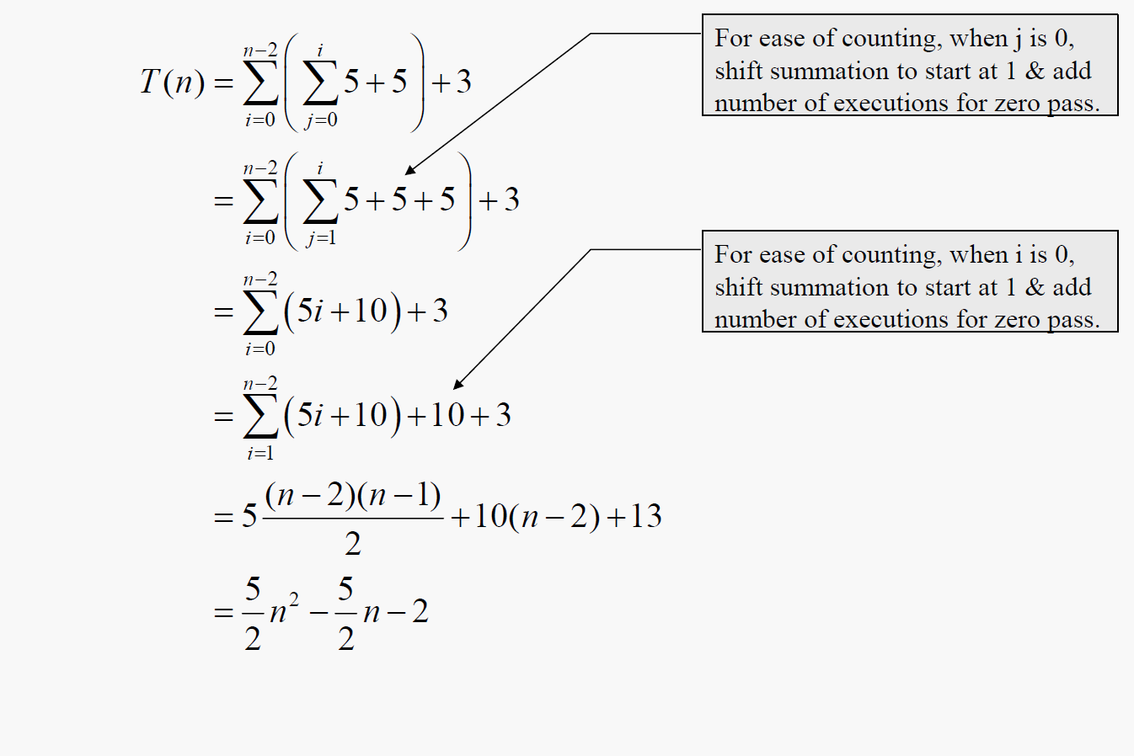
Algorithm analysis

Slide 47
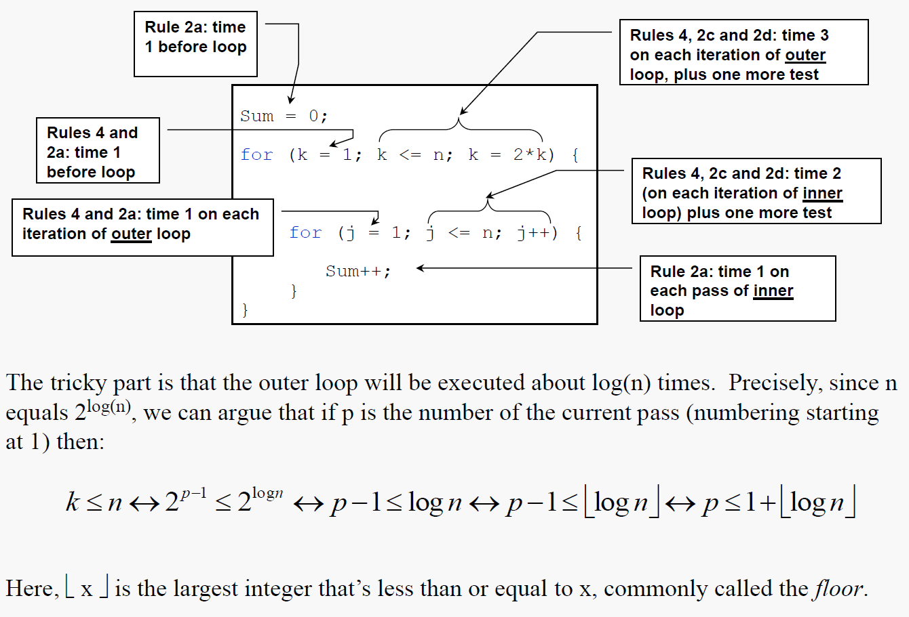
Algorithm analysis

Slide 48
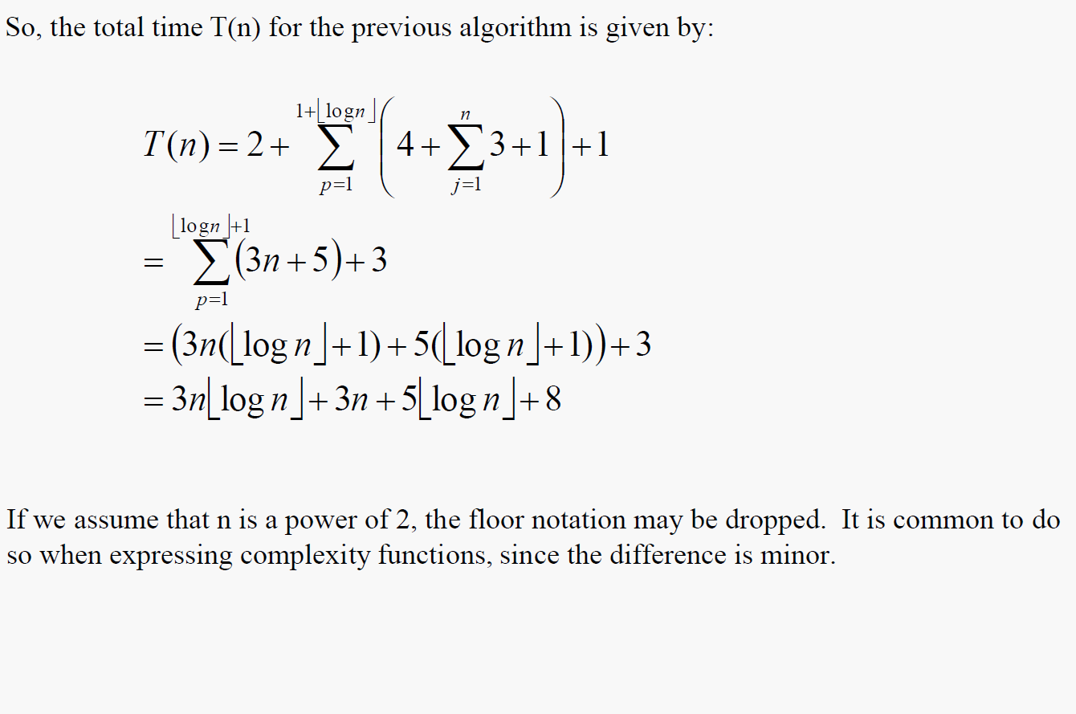
Algorithm analysis

Slide 49
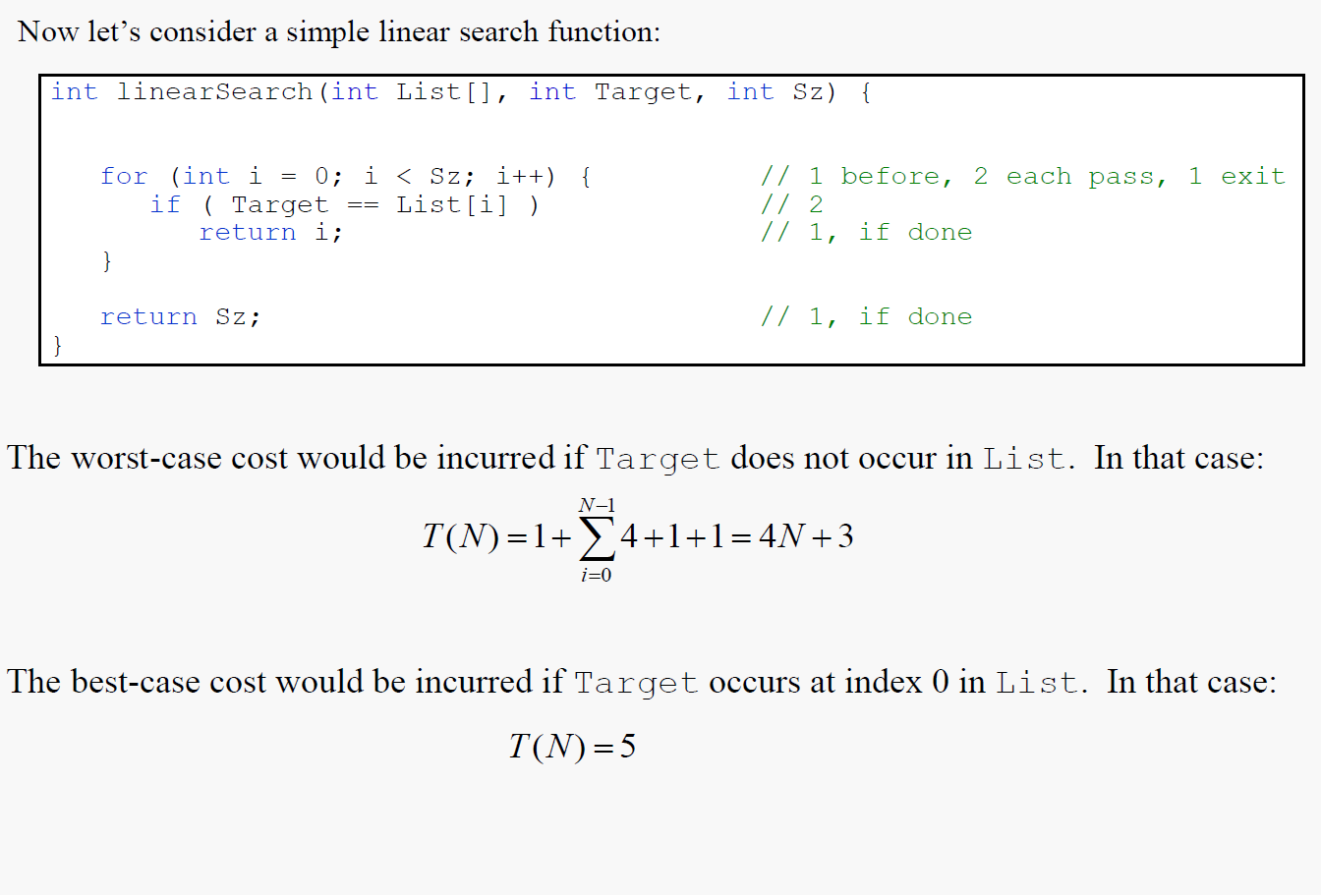
Algorithm analysis

Slide 50
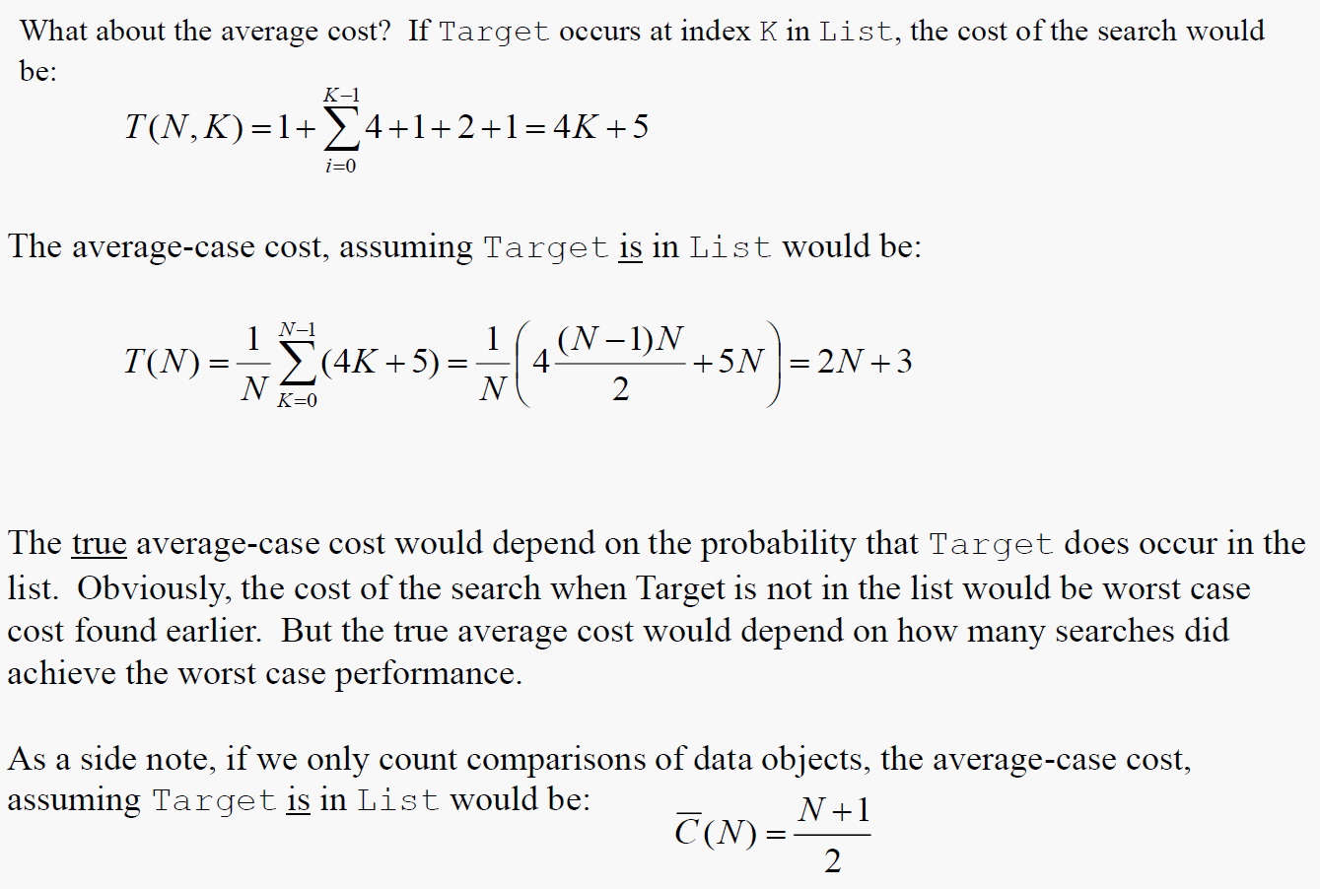
Algorithm analysis

Slide 51
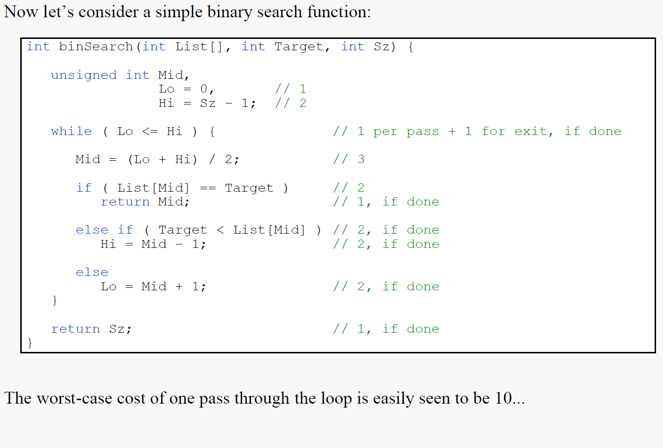
Algorithm analysis

Slide 52
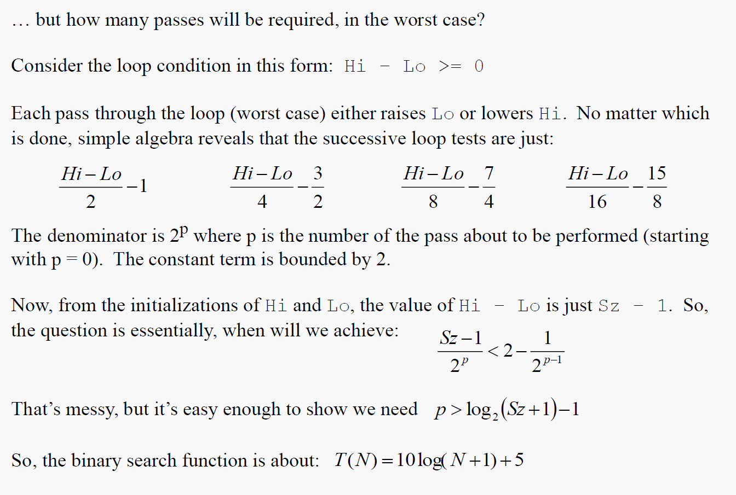
Algorithm analysis

Slide 53
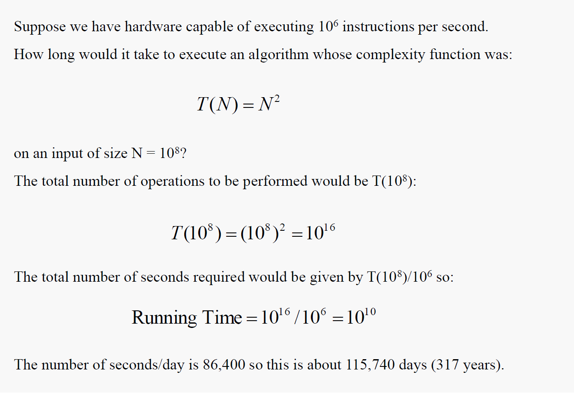
Algorithm analysis

Slide 54
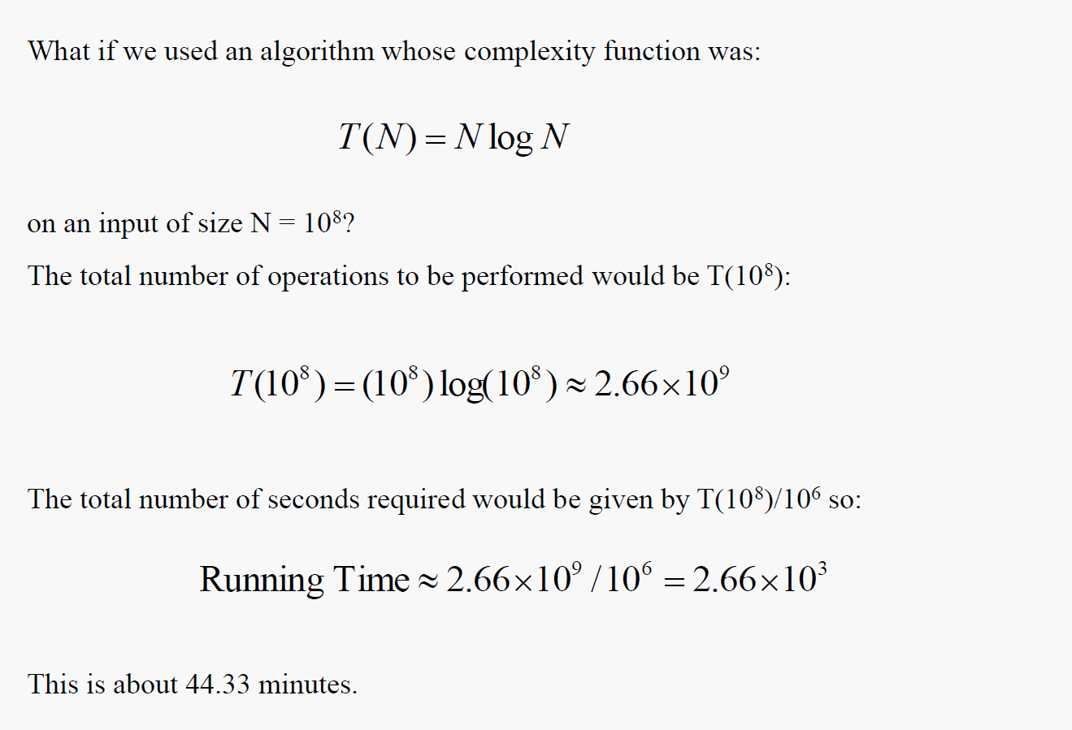
Algorithm analysis

Slide 55
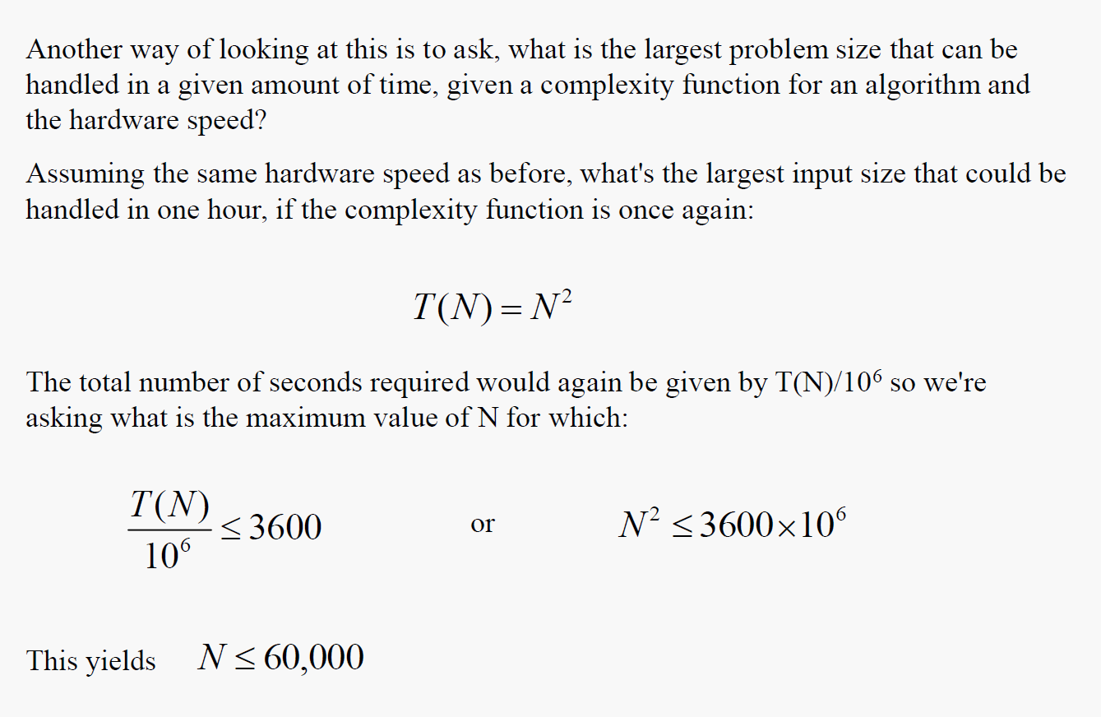
Algorithm analysis

Slide 56
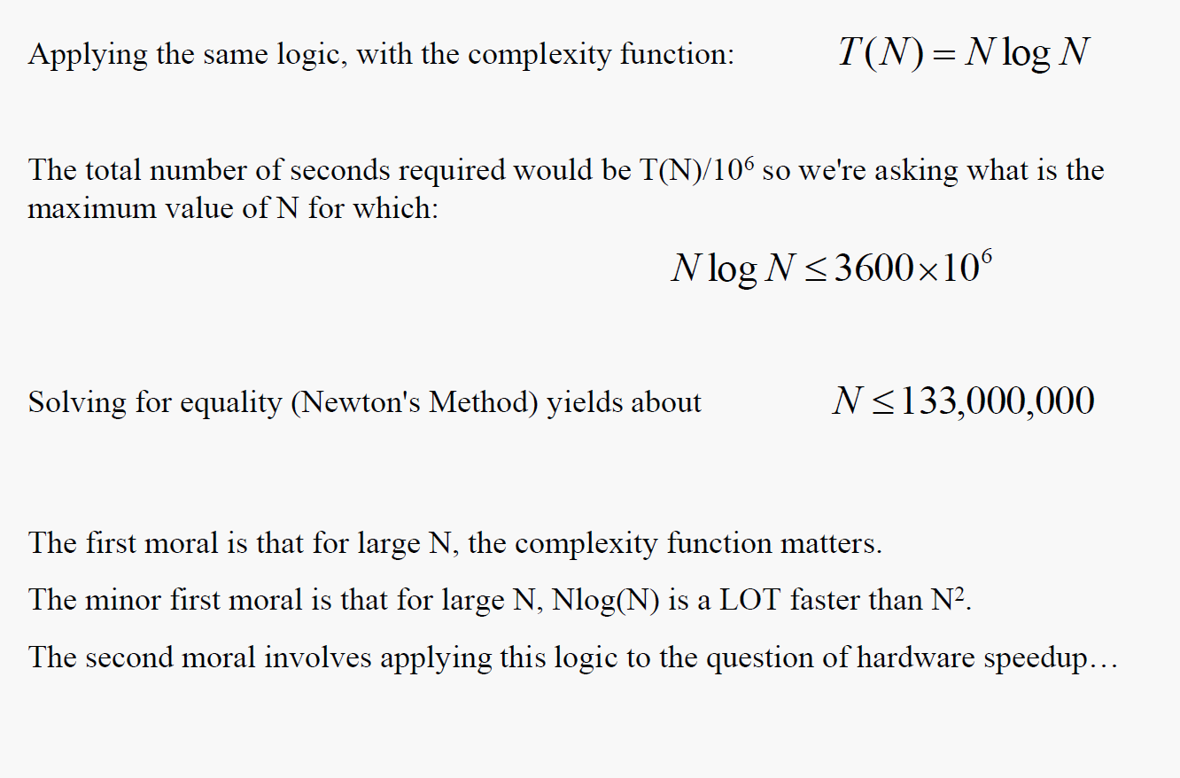
Algorithm analysis

Slide 57
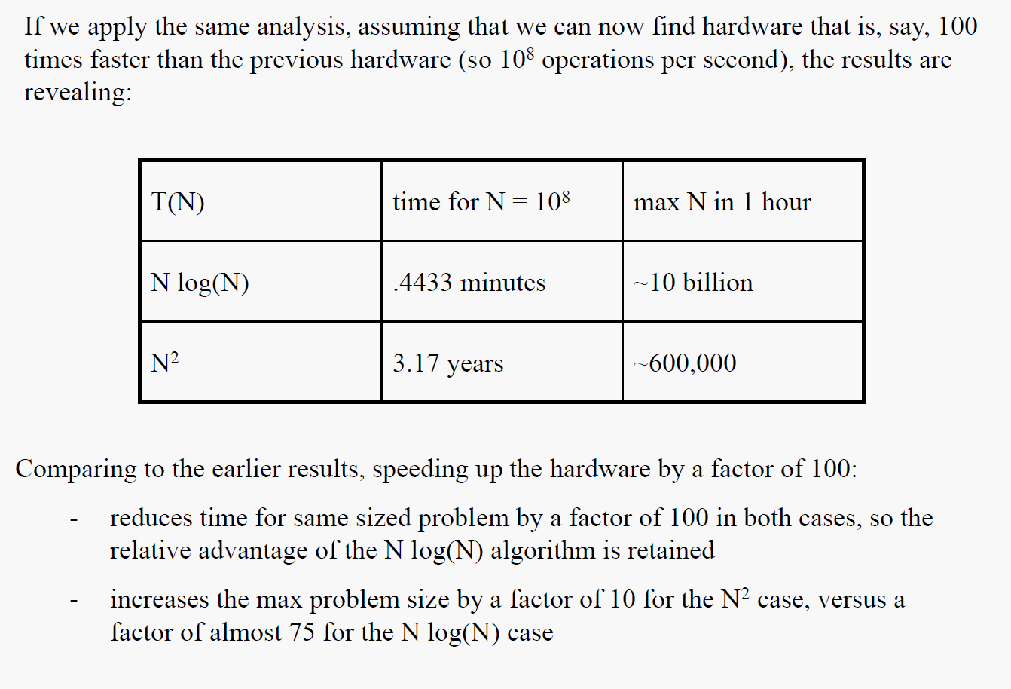
Algorithm analysis

Slide 58
Sorting
Because sorting is so important, naturally it has been studied intensively and many algorithms have been devised. Some of these algorithms are straightforward adaptations of schemes we use in everyday life. Others are totally alien to how humans do things, having been invented to sort thousands or even millions of records stored on the computer. After years of study, there are still unsolved problems related to sorting. New algorithms are still being developed and refined for special purpose applications.

Slide 59
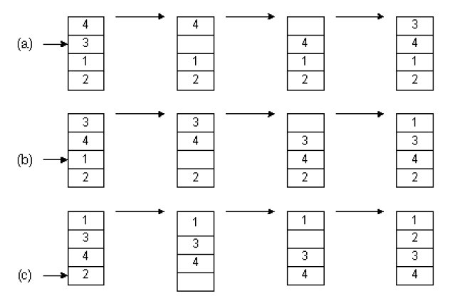
Sorting
Insertion Sort
One of the simplest methods to sort an array is an insertion sort. An example of an insertion sort occurs in everyday life while playing cards. To sort the cards in your hand you extract a card, shift the remaining cards, and then insert the extracted card in the correct place. This process is repeated until all the cards are in the correct sequence. Both average and worst-case time is O(n²).
Starting near the top of the array, we extract the 3. Then the above elements are shifted down until we find the correct place to insert the 3. This process repeats Figure(b) with the next number. Finally, in Figure(c), we complete the sort by inserting 2 in the correct place.

Slide 60
Sorting
Assuming there are n elements in the array, we must index through n - 1 entries. For each entry, we may need to examine and shift up to n - 1 other entries, resulting in a O(n²) algorithm. The insertion sort is an in-place sort. That is, we sort the array in-place. No extra memory is required. The insertion sort is also a stable sort. Stable sorts retain the original ordering of keys when identical keys are present in the input data.

Slide 61
Sorting
Shell Sort
Shell sort, developed by Donald L. Shell, is a non-stable in-place sort. Shell sort improves on the efficiency of insertion sort by quickly shifting values to their destination. Average sort time is O(n^{7/6}), while worst-case time is O(n^{4/3}).
We begin by doing an insertion sort using a spacing of two. In the first frame we examine numbers 3-1. Extracting 1, we shift 3 down one slot for a shift count of 1. Next we examine numbers 5-2. We extract 2, shift 5 down, and then insert 2. After sorting with a spacing of two, a final pass is made with a spacing of one. This is simply the traditional insertion sort. The total shift count using shell sort is 1+1+1 = 3. By using an initial spacing larger than one, we were able to quickly shift values to their proper destination.

Slide 62
Sorting
Various spacing may be used to implement a shell sort. Typically the array is sorted with a large spacing, the spacing reduced, and the array sorted again. On the final sort, spacing is one. Although the shell sort is easy to comprehend, formal analysis is difficult. In particular, optimal spacing values elude theoreticians.

Slide 63
Sorting
Quicksort
Although the shell sort algorithm is significantly better than insertion sort, there is still room for improvement. One of the most popular sorting algorithms is quicksort. Quicksort executes in O(n lg n) on average, and O(n²) in the worst-case. However, with proper precautions, worst-case behavior is very unlikely. Quicksort is a non-stable sort. It is not an in-place sort as stack space is required.
The quicksort algorithm works by partitioning the array to be sorted, then recursively sorting each partition. In Partition one of the array elements is selected as a pivot value. Values smaller than the pivot value are placed to the left of the pivot, while larger values are placed to the right. pivot selected is 3. Indices are run starting at both ends of the array. One index starts on the left and selects an element that is larger than the pivot, while another index starts on the right and selects an element that is smaller than the pivot.

Slide 64
Sorting
As the process proceeds, it may be necessary to move the pivot so that correct ordering is maintained. In this manner, QuickSort succeeds in sorting the array. If we’re lucky the pivot selected will be the median of all values, equally dividing the array. For a moment, let’s assume that this is the case. Since the array is split in half at each step, and Partition must eventually examine all n elements, the run time is O(n lg n). To find a pivot value, Partition could simply select the first element (A[Lb]). All other values would be compared to the pivot value, and placed either to the left or right of the pivot as appropriate. However, there is one case that fails miserably. Suppose the array was originally in order. Partition would always select the lowest value as a pivot and split the array with one element in the left partition, and Ub - Lb elements in the other. Each recursive call to quicksort would only diminish the size of the array to be sorted by one. Therefore n recursive calls would be required to do the sort, resulting in a O(n²) run time. One solution to this problem is to randomly select an item as a pivot. This would make it extremely unlikely that worst-case behavior would occur.
For short arrays, insertSort is called. Due to recursion and other overhead, quicksort is not an efficient algorithm to use on small arrays. Consequently, any array with fewer than 50 elements is sorted using an insertion sort.
After an array is partitioned, the smallest partition is sorted first. This results in a better utilization of stack space, as short partitions are quickly sorted and dispensed with.

Slide 65
Sorting
Comparison
In this section we will compare the sorting algorithms covered: insertion sort, shell sort, and quicksort. There are several factors that influence the choice of a sorting algorithm:
Stable sort. Recall that a stable sort will leave identical keys in the same relative position in the sorted output. Insertion sort is the only algorithm covered that is stable.
Space. An in-place sort does not require any extra space to accomplish its task. Both insertion sort and shell sort are in-place sorts. Quicksort requires stack space for recursion, and therefore is not an in-place sort. Tinkering with the algorithm considerably reduced the amount of time required.
Time. The time required to sort a dataset can easily become astronomical
Simplicity. The number of statements required for each algorithm. Simpler algorithms result in fewer programming errors.

Slide 66
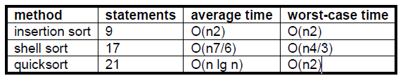
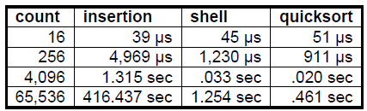
Sorting
Comparison of Sorting Methods
Sort Timings

Slide 67
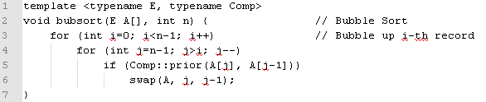
Sorting
Bubble Sort
Next sorting algorithm is called Bubble Sort. Bubble Sort is often taught in introductory computer science courses. This is unfortunate, because Bubble Sort has no redeeming features whatsoever. It is a relatively slow sort, it is no easier to understand than Insertion Sort, it does not correspond to any intuitive counterpart in “everyday” use, and it has a poor best-case running time. However, Bubble Sort can serve as the inspiration for a better sorting algorithm. Bubble Sort consists of a simple double for loop. The first iteration of the inner for loop moves through the record array from bottom to top, comparing adjacent keys. If the lower-indexed key’s value is greater than its higher-indexed neighbor, then the two values are swapped. Once the smallest value is encountered, this process will cause it to “bubble” up to the top of the array. The second pass through the array repeats this process.

Slide 68
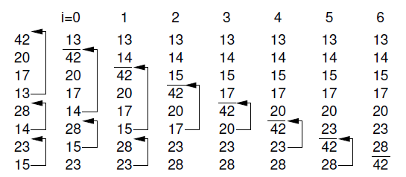
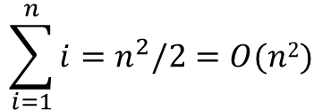
Sorting
An illustration of Bubble Sort. Each column shows the array after
the iteration with the indicated value of i in the outer for loop. Values above the
line in each column have been sorted. Arrows indicate the swaps that take place
during a given iteration.
Determining Bubble Sort’s number of comparisons is easy. Regardless of the
arrangement of the values in the array, the number of comparisons made by the
inner for loop is always i, leading to a total cost of Bubble Sort’s running time is roughly the same in the best, average, and worst cases.
$$\sum_{i=1}^{n}{{i=n}^{2}/2}=O(n2)$$

Slide 69
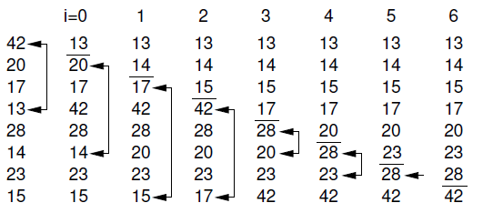
Sorting
Selection Sort
Consider again the problem of sorting a pile of phone bills for the past year. Another
intuitive approach might be to look through the pile until you find the bill for
January, and pull that out. Then look through the remaining pile until you find the
bill for February, and add that behind January. Proceed through the ever-shrinking
pile of bills to select the next one in order until you are done. This is the inspiration
for our last O(n²) sort, called Selection Sort. The i-th pass of Selection Sort “selects”
the i-th smallest key in the array, placing that record into position i. In other
words, Selection Sort first finds the smallest key in an unsorted list, then the second
smallest, and so on.

Slide 70
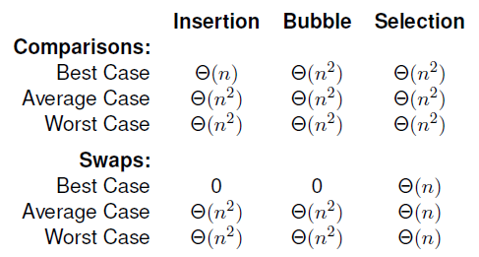
Sorting
Selection Sort (as written here) is essentially a Bubble Sort, except that rather
than repeatedly swapping adjacent values to get the next smallest record into place,
we instead remember the position of the element to be selected and do one swap
at the end. Thus, the number of comparisons is still O(n²), but the number of
swaps is much less than that required by bubble sort. Selection Sort is particularly advantageous when the cost to do a swap is high, for example, when the elements
are long strings or other large records. Selection Sort is more efficient than Bubble
Sort (by a constant factor) in most other situations as well.

Slide 71

Searching

Slide 72
Searching
Organizing and retrieving information is at the heart of most computer applications,
and searching is surely the most frequently performed of all computing tasks.
Search can be viewed abstractly as a process to determine if an element with a particular value is a member of a particular set. The more common view of searching is an attempt to find the record within a collection of records that has a particular key value, or those records in a collection whose key values meet some criterion such as falling within a range of values.
Linear search
The simplest search algorithm is linear search. In linear search, we look at each item in the list in turn, quitting once we find an item that matches the search term or once we’ve reached the end of the list. Our “return value” is the index at which the search term was found, or some indicator that the search term was not found in the list.

Slide 73
Searching
Binary search
The idea behind binary search is that each time we make a comparison, we eliminate half of the list, until we either find the search term or determine that the term is not in the list. We do this by looking at the middle item in the list, and determining if our search term is higher or lower than the middle item.
The best case for binary search still occurs when we find the search term on the first try. In this case, the search term would be in the middle of the list. As with linear search, the best case for binary search is O(1).
the worst case for binary search is O(log n).

Slide 74
Searching
Interpolation Search
(Also known as Dictionary Search)
If we know nothing about the distribution of key values, then binary search
is the best algorithm available for searching a sorted array. However, sometimes we do know something about the expected key distribution. Consider the typical behavior of a person looking up a word in a large dictionary. Most people certainly do not use sequential search! Typically, people use a modified form of binary search, at least until they get close to the word that they are looking for. The search generally does not start at the middle of the dictionary. A person looking for a word starting with ‘S’ generally assumes that entries beginning with ‘S’ start about three quarters of the way through the dictionary. Thus, he or she will first open the dictionary about three quarters of the way through and then make a decision based on what is found as to where to look next. In other words, people typically use some knowledge about the expected distribution of key values to “compute” where to look next.

Slide 75

Searching
Search L at a position that is appropriate to the value of X.
Repeat as necessary to recalculate p for future searches.
This equation is computing the position of K as a fraction of the distance between
the smallest and largest key values. This will next be translated into that
position which is the same fraction of the way through the array, and this position
is checked first. As with binary search, the value of the key found eliminates all
records either above or below that position. The actual value of the key found can
then be used to compute a new position within the remaining range of the array.
The next check is made based on the new computation. This proceeds until either
the desired record is found, or the array is narrowed until no records are left.

Slide 76
Searching
Quadratic Binary Search (QBS)
A variation on dictionary search is known as Quadratic Binary Search (QBS).
If items are placed in an array and sort them in either ascending or descending order on the key first, then a better performance can be obtained by using QBS. In Quadratic Algorithm, first we calculate the middle element,1/4th element and 3/4th element . then compare the key with the item in the middle ,1/4th and 3/4th positions of the array.

Slide 77
Bibliography
Bibliography
Clifford A. Shaffer - Data Structures and Algorithm Analysis, Edition 3.2
Cormen, Thomas H., Charles E. - Introduction to Algorithms, 3rd edition.
Thomas Niemann - epaperpress.com

Slide 78
Exersices
1.Define an ADT for a list of integers. First, decide what functionality your
ADT should provide. Then, specify your ADT in the form of an abstract class declaration, showing the functions, their parameters, and their return types.
2. A deque (pronounced “deck”) is like a queue, except that items may be added
and removed from both the front and the rear. Write either an array-based or
linked implementation for the deque.
3. How would you sort an array of about 1000 integers from lowest value to
highest value? Write down at least five approaches to sorting the array. Do
not write algorithms in C++ or pseudocode. Just write a sentence or two for
each approach to describe how it would work.
4.Think of an algorithm to find the maximum value in an (unsorted) array.
Now, think of an algorithm to find the second largest value in the array.
Which is harder to implement? Which takes more time to run (as measured
by the number of comparisons performed)? Now, think of an algorithm to
find the third largest value. Finally, think of an algorithm to find the middle
value. Which is the most difficult of these problems to solve?

Slide 79
Exersices
5. Write a recursive function named search that takes as input the pointer to
the root of a binary tree (not a BST!) and a value K, and returns true if
value K appears in the tree and false otherwise.
6. Write an algorithm that takes as input the pointer to the root of a binary
tree and prints the node values of the tree in level order. Level order first
prints the root, then all nodes of level 1, then all nodes of level 2, and so
on. Hint: Preorder traversals make use of a stack through recursive calls.
Consider making use of another data structure to help implement the levelorder
traversal.
7. Write a recursive function that returns the height of a binary tree.

Slide 80
Exersices
8. You must keep track of some data. Your options are:
(1) A linked-list maintained in sorted order.
(2) A linked-list of unsorted records.
(3) A binary search tree.
(4) An array-based list maintained in sorted order.
(5) An array-based list of unsorted records.
For each of the following scenarios, which of these choices would be best?
Explain your answer.
(a) The records are guaranteed to arrive already sorted from lowest to highest
(i.e., whenever a record is inserted, its key value will always be
greater than that of the last record inserted). A total of 1000 inserts will
be interspersed with 1000 searches.
(b) The records arrive with values having a uniform random distribution
(so the BST is likely to be well balanced). 1,000,000 insertions are
performed, followed by 10 searches.
(c) The records arrive with values having a uniform random distribution (so
the BST is likely to be well balanced). 1000 insertions are interspersed
with 1000 searches.
(d) The records arrive with values having a uniform random distribution (so
the BST is likely to be well balanced). 1000 insertions are performed,
followed by 1,000,000 searches.

Slide 81
Exersices
1.
- Given a list of numbers in random order, write an algorithm to find the kth smallest number in the list.
- Write an algorithm, that does that in O(nlog(n)).
- Can you do a linear time?
1.1
Write an algorithm for finding the kth prime number.
See if you could optimize it. What's its complexity?
- Use the Sieve of Eratosthenes and compare its complexity with your code.
2
- Get familiar with the implementation of the selection and the insertion sort
- What are the main differences between them
Answer: - insertion - performs less comparisons depending on how sorted is the input array; selection - has to scan the remaining parts of the array => Selection is always quadratic - insertion could become O(n)
- selection - number of swaps (writes) is O(n); insertion is O(n^2). Selection sort will be better for sorting on flash memory.
- for keeping list sorted and adding to it - insertion; The cost for linked list is O(1) for insertion; the cost for array - O(N) => if use array - selection, if not - insertion
- What are the main advantages and disadvantages considering other algorithms, with O(nlog(n)) complexity
- Using your answers, write a program, that chooses which algorithm to use for a given input and then sort it.

Slide 82
Exersices
3. Едно време, в дивия северозапад, хората са се пребивали най-редовно, но пък за сметка на това, след всеки бой тези, които са още в съзнание, продължавали да пият и така, ако започнат нов кютек, все едно са били напълно здрави. Това най-често били победителите, а победените - те лежали в безсъзнание някъде на спокойствие. Опишете такъв "турнир" от биячи, които са записани в книгата на кръчмата. Заредете имената им в контейнер по ваш избор, след което ги групирайте по двойки. Приемете, че всеки почерпeн има по 100% здраве и никой не може да му нанесе повече от 20% щети. Биячите се бият последователно - първо удря единият, после другият. Бият се, докато единият не победи - тоест, другият остане на 0% здраве. Използвайте генериране на random числа за всеки двубой. След всеки кръг направете нови двойки и така докато не излъчите победител.
*Решете задачата с нишки, така че всеки от ударите между двама да се случват асинхронно.
4.
- Write a multithreaded merge sort;
- Compare it against the initial implementation.

Slide 83

www.visteon.com

